Slide 1

Anantha Lakshmi
INSTITUTE OF TECHNOLOGY & SCIENCES
(AUTONOMOUS)
Brief Presentation
on
Design of 4-bit Multiplier using Modified Gate Diffusion Input Technology for Low Power
Applications
Under Esteemed Guidance of
Mr .C. Obulesu M. Tech.,
Presented by
S.B.CHINMAYI 222G1A0441
G.HARIKEERTHANA 232G5A0412
Y.VIJAYENDRA 222G1A0450
K.PAVAN KALYAN 232G5A0413
A. NANDA 222G1A0401
Department of
ELECTRONICS AND COMMUNICATION ENGINEERING
(A.Y. 2025-2026 )

Slide 2
CONTENTS
Objective
Introduction
Literature Survey
Existing Model
Limitations of Existing Model
Proposed Design
CMOS to MGDI Implementation
Working Model
Result
Comparison Table
Applications
Conclusion

Slide 3
OBJECTIVE
Multipliers are important components in digital systems.
Conventional multipliers consume high power.
This project uses MGDI technology to reduce power consumption.
The design improves speed and efficiency in VLSI circuits.

Slide 4
INTRODUCTION
Multipliers are used in Digital Signal Processing and Micro Processors.
Traditional CMOS circuits require more transistors.
Power consumption is a major problem in digital circuits.
MGDI technique helps reduce power and delay.

Slide 5
LITERATURE SURVEY
Multipliers are important components used in digital circuits, signal processing, and VLSI systems. Normal multiplier designs use more power and more hardware.
Many low-power design techniques are developed to reduce power consumption and area in digital circuits. GDI is one of the efficient techniques.
Modified Gate Diffusion Input (MGDI) improves the GDI method by reducing power, delay, and transistor count.
Existing multiplier designs using conventional adders consume more power and have more propagation delay.
In this project, a 4-bit multiplier using MGDI adders is designed to achieve low power consumption, high speed, and better performance compared to existing systems.

Slide 6
EXISTING MODEL
Conventional multipliers use CMOS technology.
Here, we used 6 (3 PMOS&3NMOS) transistors.
Consumes more power during operation.
Circuit design becomes complex.

Slide 7
LIMITATIONS OF EXISTING MODEL
• Existing CMOS multiplier circuits consume high power during operation.
• The design requires 6 number of transistors to implement the circuit.
• The circuit produces higher propagation delay, which reduces speed.
• The overall design occupies more chip area in VLSI implementation.

Slide 8
Proposed design
• The proposed system designs a 4-bit multiplier using Modified Gate Diffusion Input (MGDI) technology. • MGDI technique reduces the number of transistors from 6 (CMOS) to 2 (MGDI) in logic gates. • The design helps to reduce power consumption in digital circuits. • The proposed multiplier improves speed and efficiency in VLSI applications.

Slide 9
CMOS to MGDI Implementation .
• Multiplier circuit is first designed using CMOS logic gates. • CMOS gates require more number of transistors (6T). • CMOS gates are replaced with MGDI logic gates (2T). • MGDI reduces transistor count, power consumption, and delay. • This improves speed and efficiency of the multiplier.

Slide 10
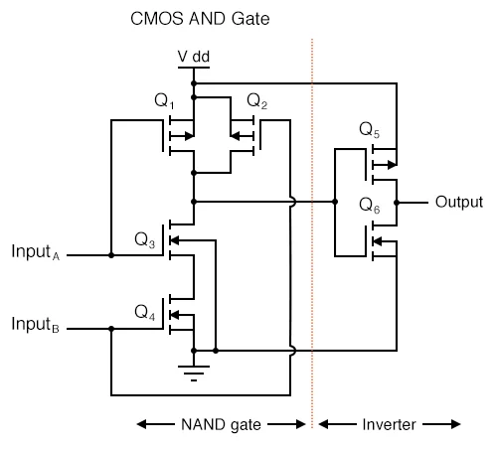
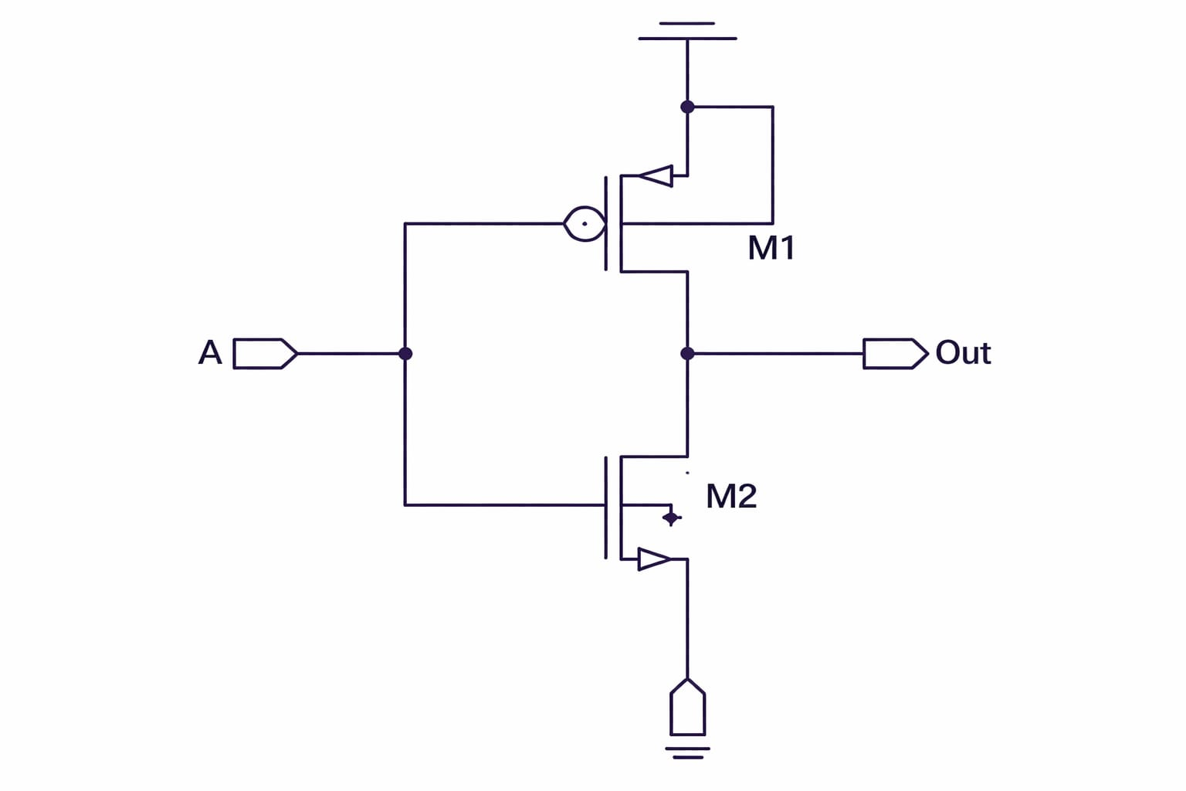
Fig (a):CMOS AND gate
Fig (b): MGDI AND gate

Slide 11
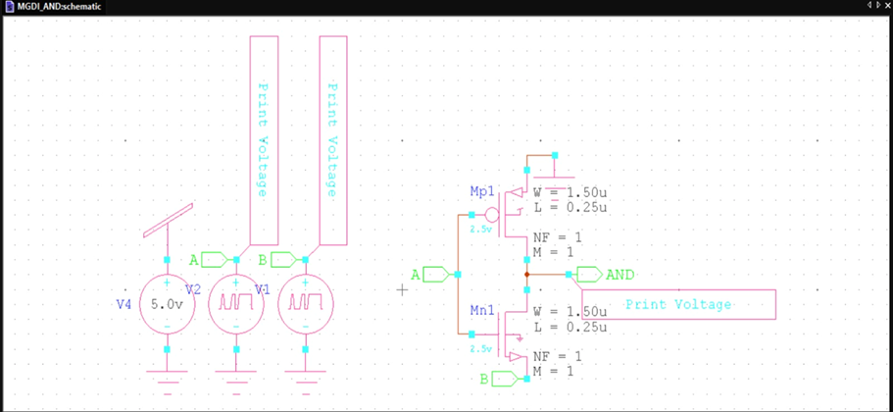
Fig : MGDI Schematic Diagram

Slide 12
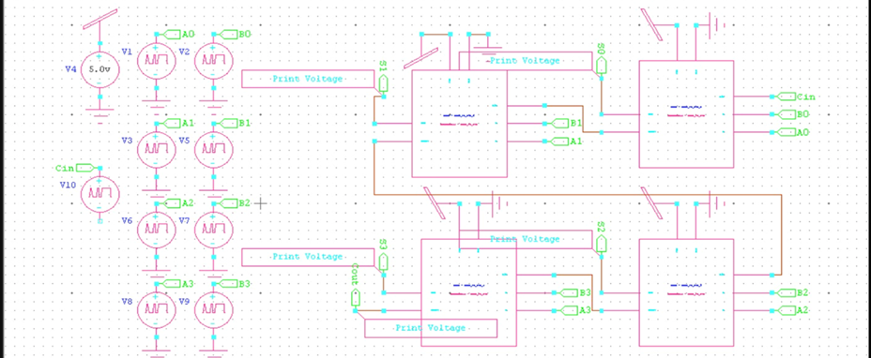
WORKING MODEL
Fig : Multiplier Schematic Diagram

Slide 13
1. Input Stage: Two 4-bit binary numbers (A and B) are given as inputs to the multiplier circuit.
2. Partial Product Generation: The MGDI logic gates generate partial products by multiplying each bit of the input numbers.
3. Addition Process: The generated partial products are added using adder circuits to perform the multiplication operation.
4. Final Output: The circuit produces the 8-bit multiplication result, which represents the product of the two input numbers.

Slide 14
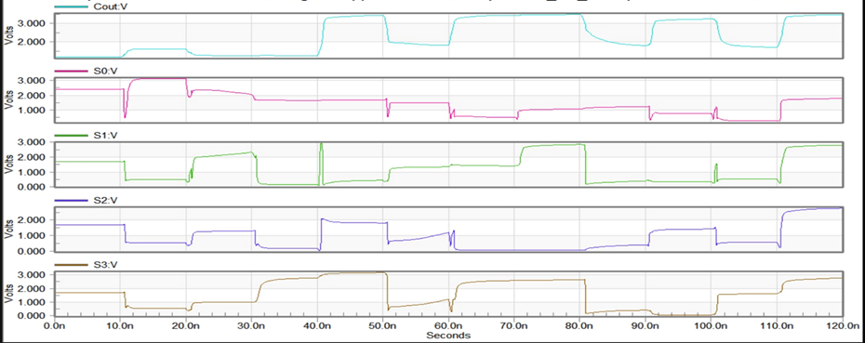
result
Fig: Final wave form

Slide 15
COMPARISION TABLE
PARAMETERS | EXISTING CMOS | PROPOSED MGDI
Transistor Count | 6 | 2
Power Consumption | 10 µW | 3 µW
Propagation Delay | 8 ns | 3 ns
Area | 30 µm² | 10 µm²
Speed | Medium | High

Slide 16
APPLICATIONS
Digital Signal Processing (DSP) systems.
Microprocessors and ALU circuits.
Image processing applications.
Communication systems.
Low-power VLSI circuits.

Slide 17
CONCLUSION
As we used MGDI Technology transistor count is reduced.
Power consumption is reduced compared to CMOS design.
Circuit performance and efficiency are improved.
Suitable for low-power VLSI applications.

Slide 18
references
Bini Joy, N. Akshaya, and M. Sathia Priya, ―Design of Multiplier Using GDI Technique, International Journal of Advanced Research in Science and Engineering, vol. 4, Special Issue 2, pp. 373–375, Feb. 2025.
J. Aditya, N. Reddy, G. S. Krishna, and P. Bikki, “Novel High-Speed Vedic Multiplier”, Research Gate, Mar. 2024.
Rama Krishna Reddy, R. Tarun, C. A. Kumar, and M. V. Rao, “An Efficient Adiabatic 4-Bit Array Multiplier for Low Power Applications,” International Journal of Advanced Research in Innovative Ideas in Engineering, vol. 10, no. 2, pp. 3711–3712, 2024.
Reddaf et al., “Modeling of Schottky Diode and Optimal Matching Circuit Design for Low Power RF Energy Harvesting”, Heliyon, vol. 10, p. e27792, 2023.

Slide 19
THANK YOU !

